Slide 1

Java Building Blocks
Classes, Interfaces, Objects, etc.

Slide 2
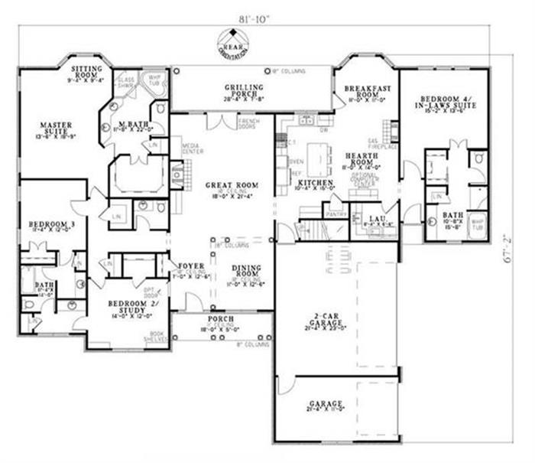
Class
A class is a blueprint or template from which objects are created (instantiated)
We like to think of a class as the code in the IDE's editor, but that is source code (.java file)
The class is the compiled byte code (.class file)

Slide 3
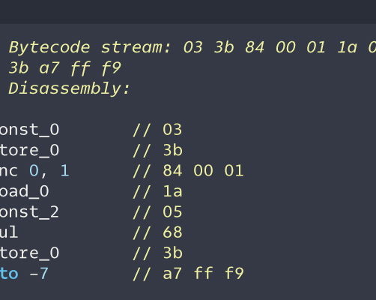
Class
The Java class loader loads .class files into memory
Each class exists only once in memory
The class defines static (class) and instance (object) variables and methods
Static variables are stored in the class memory location
Instance variables are created in the object's memory location when the class is instantiated (generated)

Slide 4
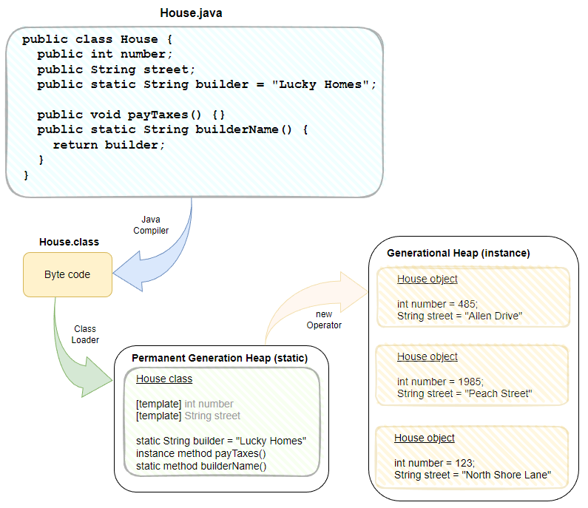
Class
Instance variables
Static variable
Instance method
Static method
Instance variables
All methods and static variables
Notes:
You create the .java file in the editor.
The Java compiler compiles the .java source to the .class byte code.
When the application is run, the class loader loads the byte code into the permanent generation heap. Static variables and all methods are in this heap.
When the new operator is used, the JVM creates an object on the generational heap and allocates space for instance variables.

Slide 5

Objects (Instances)
Objects are Instantiated (generated) based on the class template
Objects contain instance variables in memory
Objects are initially the same
Objects can be customized at creation time or later
Each object has its own separate location in memory (like a house on the same street)

Slide 6

Objects (Instances)
These houses started out the same
They changed paint
They changed curtains
They changed trees
Each change only affects the individual house (instance)

Slide 7
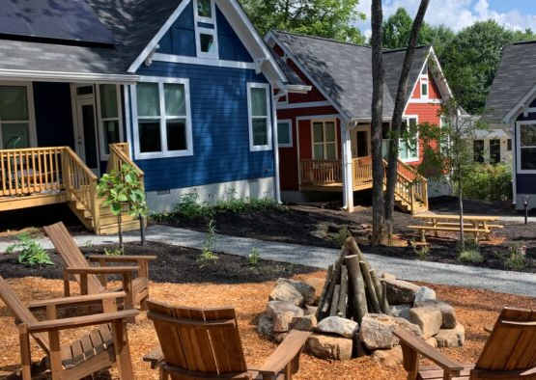
Static vs instance variables
Static is the common area "outside" the home
Paint a chair, everyone sees it
Add a trashcan – it's available to all
Instance is "inside" the home
Change a rug, only one house has it
Static variables are stored in the class memory (permanent generation heap)
Instance variables are stored in the instance memory (generational heap)
Add a bed – only one house gets it

Slide 8

Static vs instance methods
You don't need an instance to call a static method
Static methods are called on the class
ClassName.methodName()
Ex: String.format()
All methods (i.e., executable code) are stored in the class memory and not the instance memory
The difference between static and instance methods is accessibility, not functionality
Static methods cannot be overridden (affects Object-Oriented Principle of Polymorphism)

Slide 9

Static vs instance methods
Static methods can only access static elements (variables and methods)
Instance methods can access static or instance elements (variables and methods)

Slide 10

Interface
A list of services that must be provided by an implementing class
Defines the what but not the how
A contract of services provided

Slide 11

Interface
An interface defines method signatures (the what), but no method bodies (the how)
public interface HandyMan {
public void remodelHome();
public void carpentry();
public void drywallRepair();
public void repairSiding();
}

Slide 12
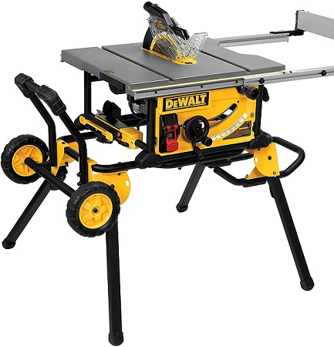
Interface
public class PowerHandymanBob
implements Handyman {
public void remodelHome() {
usePowerTools();
}
}

Slide 13

Interface
public class ManualHandymanBob
implements Handyman {
public void remodelHome() {
useHandTools();
}
}

Slide 14

Interface
Different classes may implement the interface contract in different ways
The what is the same (remodel home)
The how is different ("power tools" vs. "hand tools")

Slide 15

Java building blocks
Interface: a contract of services
Class: a template for creating instances (objects)
Contains static variables
Contains all executable code (methods)
Static: stored in the class memory
Can only access static elements
Instance: stored in object memory
Can access static elements and instance elements

